Slide 1



Digital Logic Design
Semester II
FY
Course Code
316U06C203
Jan – May 2026

Slide 2
4. Sequential Logic Circuits

Slide 3
Contents
4.1 Latches and flip-flops: Types: SR, D, JK, T flip-flops truth tables, Excitation table, and characteristics equations.
4.2 Counters: Asynchronous counters, Synchronous counters, up/down counter, mod counters using flipflops, Use of MSI devices for counters.
4.3 Registers: Shift registers using D-FF and types of shift registers (SISO, SIPO, PIPO, PISO). MSI shift register, Ring and Johnson Counter using Shift register.

Slide 4
Flip-Flop & its Types
The flip-flop is a circuit that maintains a state until directed by input to change the state. A basic flip-flop can be constructed using four-NAND or four-NOR gates. A flip-flop is popularly known as the basic digital memory circuit. It has its two states as logic 1(High) and logic 0 (Low) states.
A flip-flop is a sequential circuit which consists of a single binary state of information or data.
The digital circuit is a flip-flop which has two outputs and are of opposite states. It is also known as a Bistable Multivibrator.
Types of Flip-Flops
Given Below are the Types of Flip-Flop
SR Flip Flop
JK Flip Flop
D Flip Flop
T Flip Flop

Slide 5
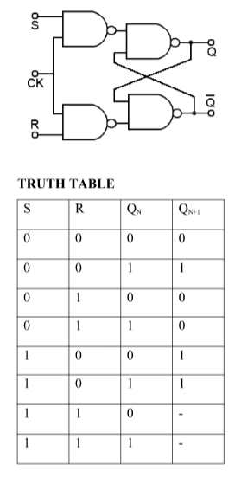
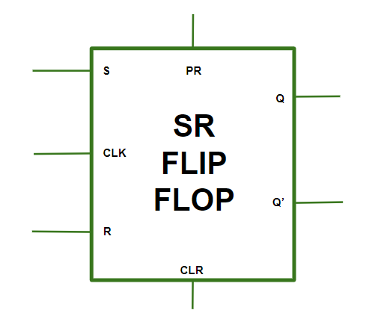
S-R Flip Flop
In the flip flop, with the help of preset and clear when the power is switched ON, the states of the circuit keeps on changing, that is it is uncertain. It may come to set(Q=1) or reset(Q’=0) state. In many applications, it is desired to initially set or reset the flip flop that is the initial state of the flip flop that needs to be assigned. This thing is accomplished by the preset(PR) and the clear(CLR).
Block Diagram of S-R Flip Flop, Circuit Diagram and Truth Table
of S-R Flip Flop:
Operations of S-R Flip Flop:
Given Below is the Operations of S-R Flip Flop
Case 1(PR=CLR=1): The asynchronous inputs are inactive and the flip flop responds freely to the S,R and the CLK inputs in the normal way.
Case 2(PR=0 and CLR=1):This is used when the Q is set to 1.
Case 3(PR=1 and CLR=0):This is used when the Q is set to 0 & Q’ is set to 1.
Case 4(PR=CLR=0): This is an invalid state.
Characteristics Equation for SR Flip Flop
Q_{N+1} = Q_{N}R' + SR'

Slide 6
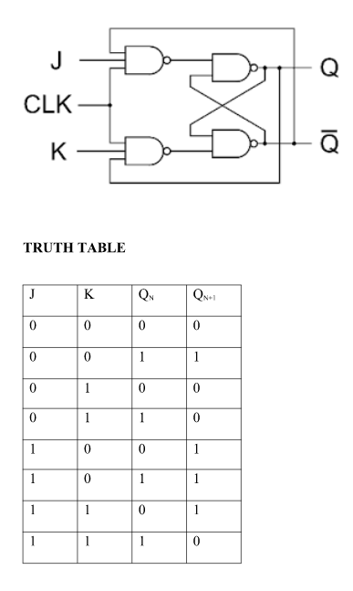
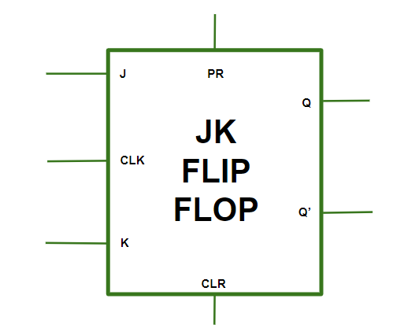
J-K Flip Flop
In JK flip flops, The basic structure of the flip flop which consists of Clock (CLK), Clear (CLR), Preset (PR).
Block Diagram of J-K Flip Flop, Circuit Diagram and
Truth Table of J-K Flip Flop
Operations of J-K Flip Flop
Given Below is the Operations of J-K Flip Flop
Case 1 (PR=CLR=0 ):This condition is in its invalid state.
Case 2 (PR=0 and CLR=1):The PR is activated which means the output in the Q is set to 1. Therefore, the flip flop is in the set state.
Case 3 (PR=1 and CLR=0):The CLR is activated which means the output in the Q’ is set to 1. Therefore, the flip flop is in the reset state.
Case 4 (PR=CLR=1):In this condition the flip flop works in its normal way whereas the PR and CLR gets deactivated.

Slide 7
Race Around Condition in J-K Flip Flop
When the J and K both are set to 1, the input remains high for a longer duration of time, then the output keeps on toggling. Toggle means that switching in the output instantly i.e. Q=0, Q’=1 will immediately change to Q=1 and Q’=0 and this continuation keeps on changing. This change in output leads to race around condition.
Characteristics Equation for JK Flip Flop
Q_{N+1} = JQ'_{N} + K'Q_{N}

Slide 8
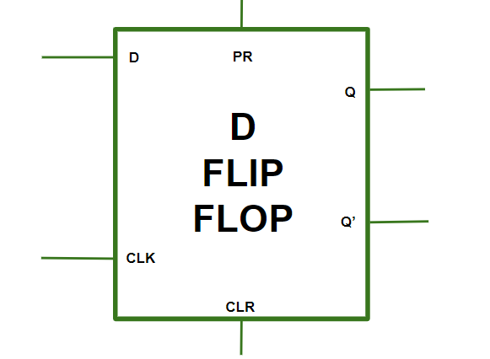
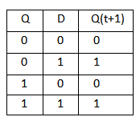
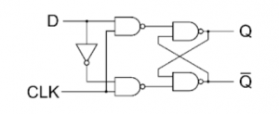
D Flip Flop
The D Flip Flop Consists a single data input(D), a clock input(CLK),and two outputs: Q and Q' (the complement of Q).
Block Diagram of D Flip Flop, Circuit Diagram and Truth Table of D Flip Flop
Operation of the D Flip-Flop
Given Below is the operation of D Flip-Flip
Case 1 (PR=CLR=0):This conditions is represents as invalid state where both PR(present) and CLR(clear) inputs are inactive.
Case 2 (PR=0 and CLR=1):This state is set state in which PR is inactive (0) and CLR is active(1) and the output Q is set to 1.
Case 3 (PR=1 and CLR=0):This state is reset state in which PR is active (1) and CLR is inactive (0) and the complementary output Q' is set to 1.
Case 4 (PR=CLR=1):In This state the flip flop behaves as normal, both PR and CLR inputs are active(1).
Characteristics Equation for D Flip Flop
Q_{N+1} = D

Slide 9
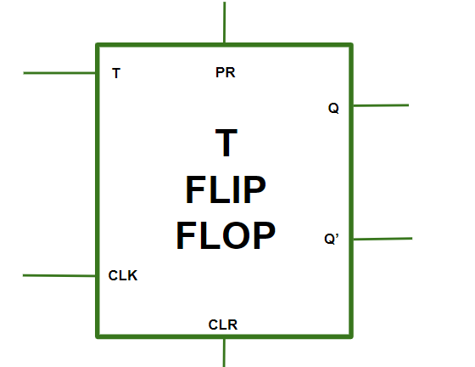
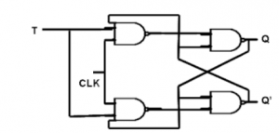
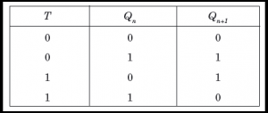
T Flip Flop
The T Flip Flop consists of data input (T), a clock input (CLK), and two outputs: Q and Q' (the complement of Q).
Block Diagram of T Flip Flop, Circuit Diagram and Truth Table of T Flip Flop
Operation of the T Flip-Flop
Given Below is the Operation of T Flip-Flop
Case 1 (T=0):In this condition the flip-flop remains in its current state regardless of clock input, also the Output Q will remain unchanged unit the value of T will not change.
Case 2 (T=1):In this condition the flip flop will change when T input is 1,At each rising or falling edge of the clock signal the output Q will be in complementary state.
Characteristics Equation for T Flip Flop
Q_{N+1} = Q'_{N}T + Q_{N}T' = Q_{N} XOR T

Slide 10
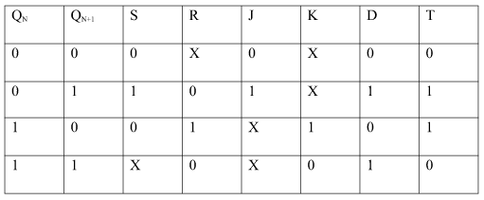
Conversion for Flip Flops
The Excitation Table of the Flip Flop can be given as
EXCITATION TABLE:

Slide 11
Applications of Flip-Flops
These are the various types of flip-flops being used in digital electronic circuits and the applications of Flip-flops are as specified below.
Counters: The Flip Flop are used in the Counter Circuits for Counting pulse or events.
Frequency Dividers: The Flip Flop are used in Frequency Dividers to divide the frequency of a input signal by a specific factor.
Shift Registers: The Shift registers consist of interconnected flip-flops that shift data serially.
Storage Registers: The Storage Resistor uses Flip Flop to store data in binary information.
Bounce elimination switch: The Flip Flop are used in Bounce elimination switch to eliminate the contact bounce.
Data storage: The Flip Flop are used in the Data Storage to store binary data temporarily or permanently.
Data transfer: The Flip Flops are used for data transfer in different electronic parts.
Latch: The Latches are the Sequential circuit which uses Flip Flop for temporary storage of data
Registers: The Registers are mode from the array of flip flop which are used to store data temporarily.
Memory: The Flip Flops are the main components in the memory unit for data storage.

Slide 12
Counters in Digital Logic
A counter is a digital electronic device that counts the number of times an event occurs using a clock signal. With each clock pulse, the count changes, such as in an up counter where the count increases by one. Counters are built using flip-flops and can follow fixed or custom sequences like 0, 1, 3, 2. They can also act as frequency dividers by reducing the input clock frequency. Counters are sequential circuits that count pulses in binary or BCD form and mainly perform counting, timing, and sequencing functions.
Counter Classification
1. Asynchronous Counter
In an asynchronous counter, there is no common (universal) clock for all flip-flops; only the first flip-flop is driven by the main clock, and each subsequent flip-flop is triggered by the output of the previous one, causing the count to ripple through the circuit.
From the timing diagram, Q0 changes immediately at the rising edge of the clock, Q1 changes at the rising edge of Q0, and the same pattern continues for Q2 and Q3. This step-by-step change creates a ripple effect through the flip-flops, which is why it is called a ripple counter or serial counter. A ripple counter is a cascade of flip-flops where the output of one flip-flop acts as the clock input for the next.

Slide 13
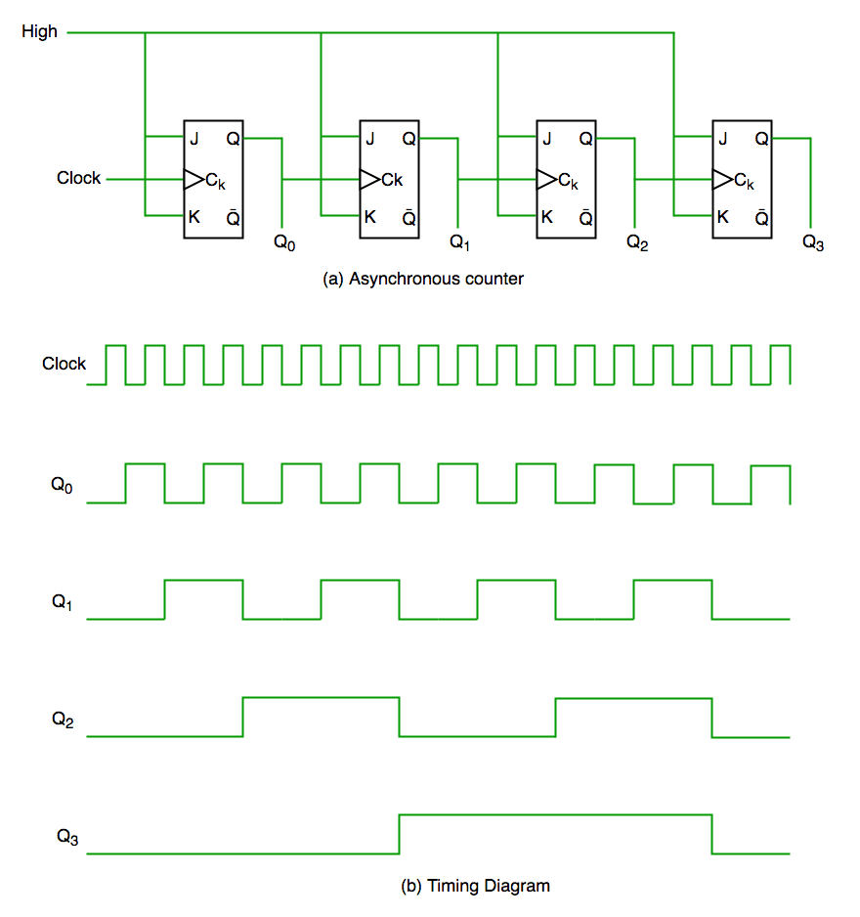

Slide 14
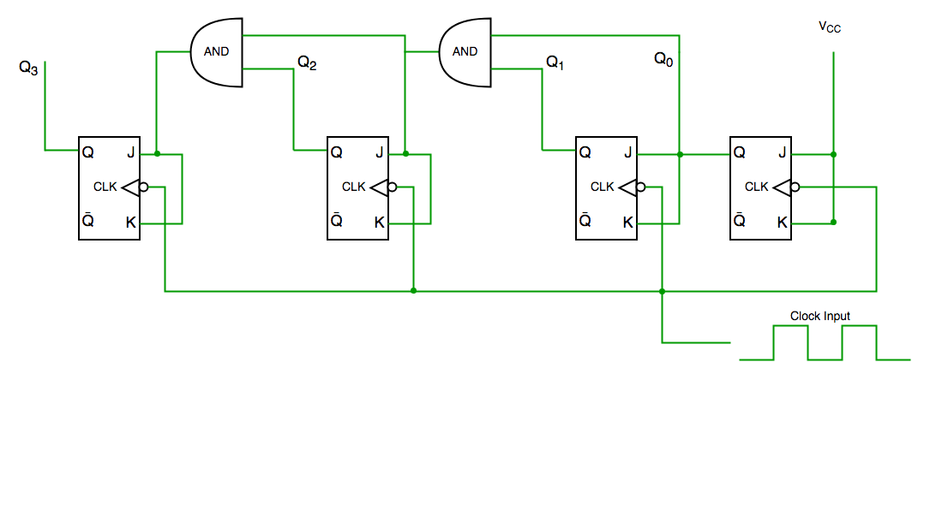
2. Synchronous Counter
Unlike an asynchronous counter, a synchronous counter uses a single global clock that drives all flip-flops simultaneously, so all outputs change in parallel. Its main advantage is that it can operate at higher frequencies because it does not suffer from cumulative delay, as the same clock is applied to every flip-flop. Hence, it is also called a parallel counter.
From the circuit diagram, Q0 responds to every falling edge of the clock, Q1 depends on Q0, Q2 depends on both Q1 and Q0, and Q3 depends on Q2, Q1, and Q0, so all flip-flops change state simultaneously under the same clock signal

Slide 15
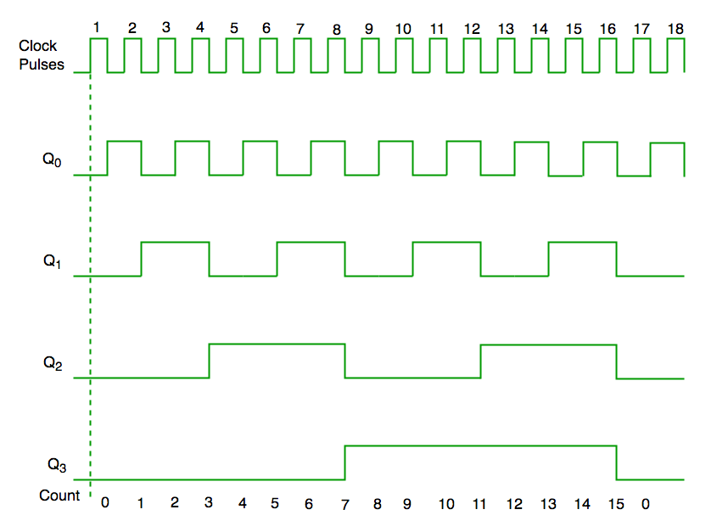

Slide 16
Decade Counter
Counts ten states and then resets to its initial state. The most common decade counter counts from 0 to 9, but it can also be designed to count any ten states within 0 to 15 in a 4-bit counter before resetting.
Truth table for simple decade counter:
Clock pulse | Q3 | Q2 | Q1 | Q0
0 | 0 | 0 | 0 | 0
1 | 0 | 0 | 0 | 1
2 | 0 | 0 | 1 | 0
3 | 0 | 0 | 1 | 1
4 | 0 | 1 | 0 | 0
5 | 0 | 1 | 0 | 1
6 | 0 | 1 | 1 | 0
7 | 0 | 1 | 1 | 1
8 | 1 | 0 | 0 | 0
9 | 1 | 0 | 0 | 1
10 | 0 | 0 | 0 | 0

Slide 17
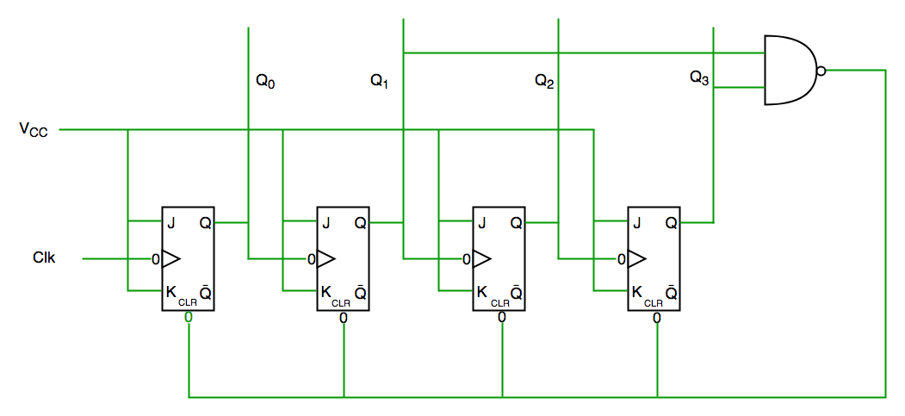

Slide 18
From the circuit diagram, a NAND gate is connected to Q3 and Q1 and its output is fed to the clear input because the binary representation of 10 is 1010. When Q3 and Q1 both become 1, the NAND gate output goes low, activating the clear input, so the counter resets at 10 and starts counting again from 0.
Important point: Number of flip flops used in counter are always greater than equal to (log₂ n) where n=number of states in counter.

Slide 19
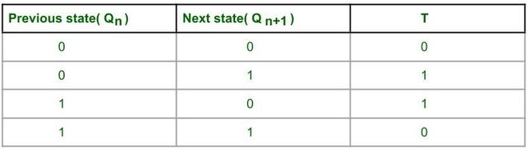
Synchronous 3 bit Up/Down counter
Steps to design Synchronous 3 bit Up/Down Counter :
1. Decide the number and type of FF -
Here we are performing 3 bit or mod-8 Up or Down counting, so 3 Flip Flops are required, which can count up to 2³-1 = 7.
Here T Flip Flop is used.
2. Write excitation table of Flip Flop -
3. Decision for Mode control input M -
When M=0 ,then the counter will perform up counting.
When M=1 ,then the counter will perform down counting.

Slide 20
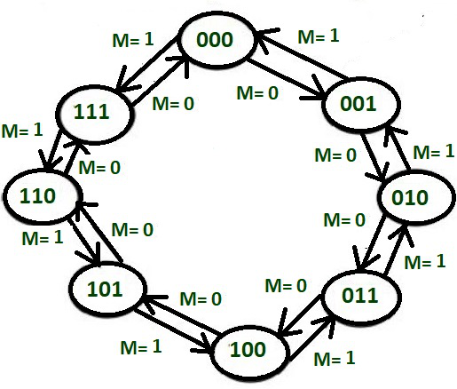
4. Draw the state transition diagram and circuit excitation table -

Slide 21
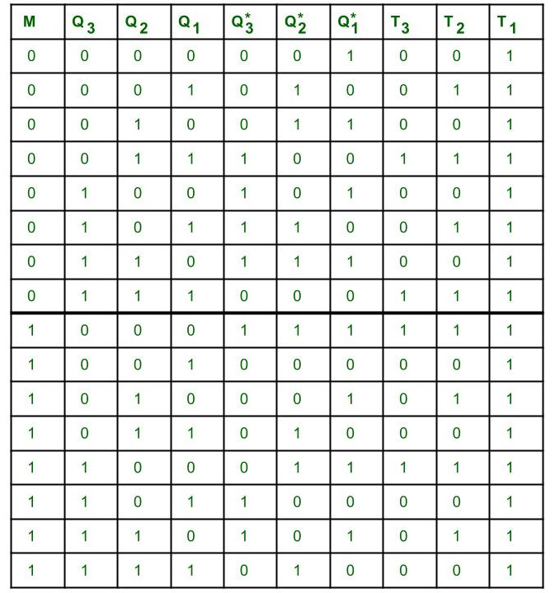
5. Circuit excitation table -
The circuit excitation table represents the present states of the counting sequence and the next states after the clock pulse is applied and input T of the flip-flops. By seeing the transition between the present state and the next state, we can find the input values of 3 Flip Flops using the Flip Flops excitation table. The table is designed according to the required counting sequence.

Slide 22
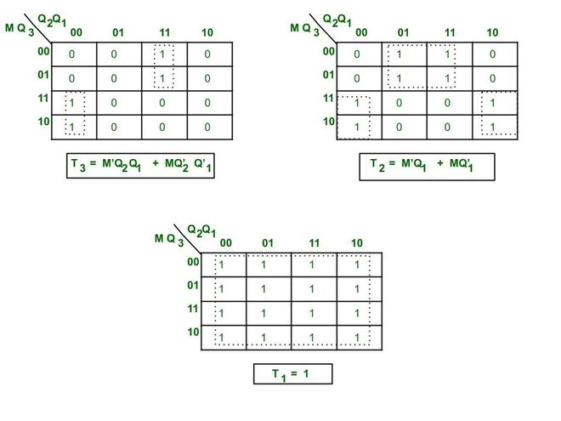
If there is a change in the output state of a flip flop (i.e. 0 to 1 or 1 to 0), then the corresponding T value becomes 1 otherwise 0.
6. Find a simplified equation using k map - Here we are finding the minimal Boolean expression for each Flip Flop input T using k map.

Slide 23
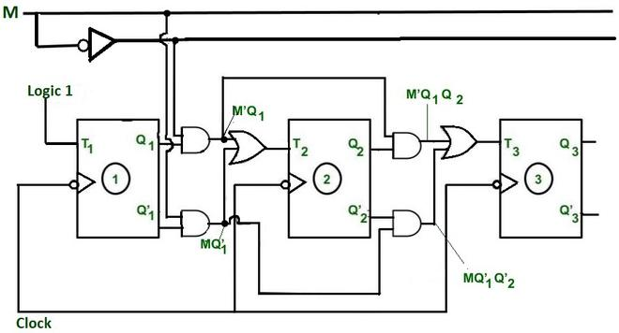
7. Create a circuit diagram - The simplified expression for Flip Flops is used to design circuit diagrams. Here all the connections are made according to simplified expressions for Flip Flops.

Slide 24
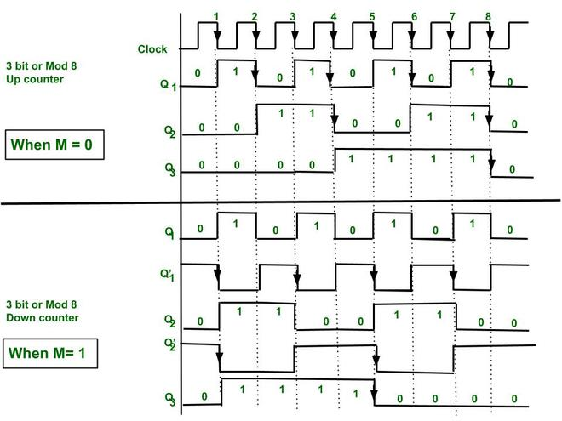
8. Timing Diagram -

Slide 25
Counters using MSI Devices

Slide 26
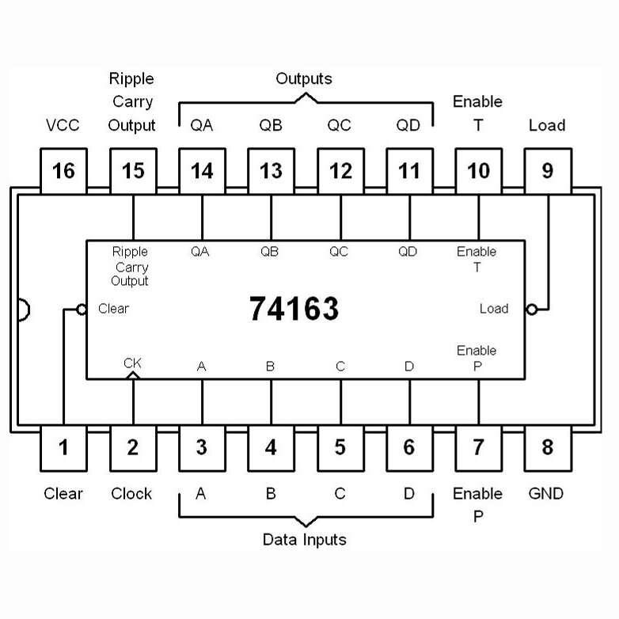

Slide 27
IC74163 Integrated Presettable Synchronous 4-bit Modulo-16 Up counter. The IC is a synchronous counter as all 4 flip-flops are integrated into the same chip & they receive the same clock pulse (clock signal).
The IC74163 is a completely programmable binary counter due to its four preset inputs, which allow it to begin counting with any loaded input by sending a low signal to the load pin.
For cascading counters with n-bit synchronous counting, a ripple-carry (RC) output terminal is provided. IC 74163, 74193 74161, etc. are 4-bit binary counters.
Features of IC74163:
Typical clock frequency 32MHz
Typical Power dissipation 93mW
4-Bit Modulo-16 Up counter.
Preset inputs are available
Synchronously programmable
Internal look-ahead (Ripple carry) for fast counting
Carry output for n-bit cascading
Active low load control line to load input number
Active low Reset terminal to reset the chip at any point.
Typical propagation time, clock to Q output 14ns

Slide 28
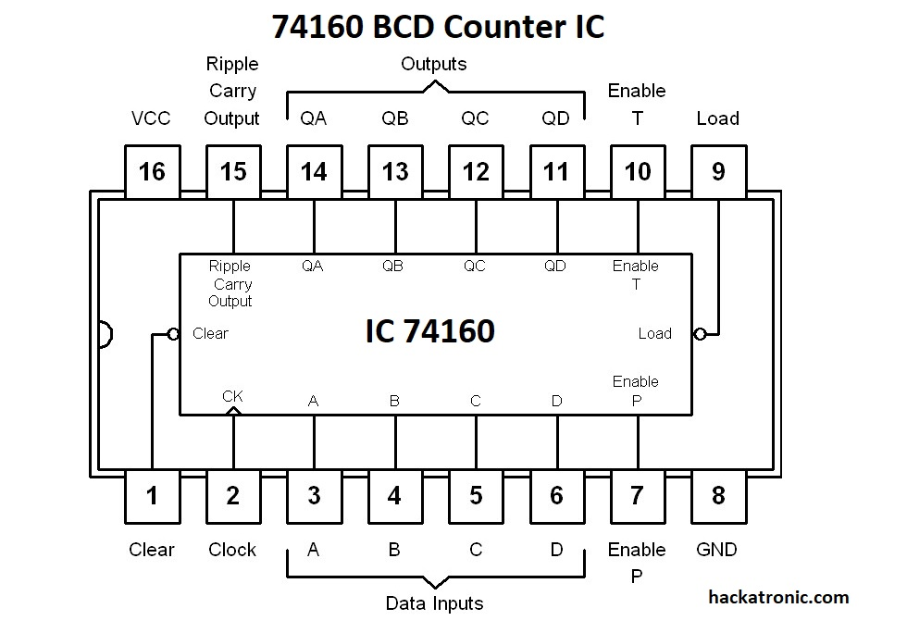
IC 7490, 74160, 74190, etc. are the decade counter chips.
IC you can see 74160 BCD Counter Circuit Diagram. It is a 16 pin BCD counter with a feature of count loading means it is presettable.
That means if you want you can count from anywhere between 0 to 9. It is a positive edge triggered IC.

Slide 29
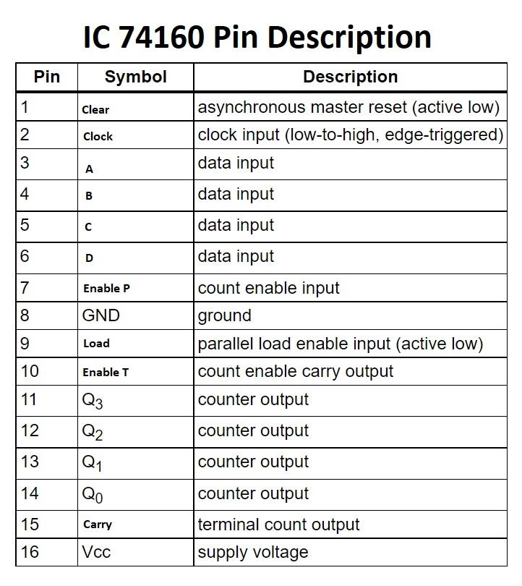
By using the A, B, C, and D data input pins we can set the output pins QA, QB, QC, and QD to high or low. The active-low clear input resets the IC to 0000. The load enables input (P) enables the count. load input loads data inputs to counter on the positive edge of the clock. Pin 15 is the ripple carry output of this IC, it makes it very easy to cascade multiple ICs to get a higher count.
Features:
Synchronous counter with the feature of loading
Two counts enable inputs for n-bit cascading
Asynchronous reset
Positive-edge triggering

Slide 30
Design a MOD 7 Counter using 74LS160

Slide 31
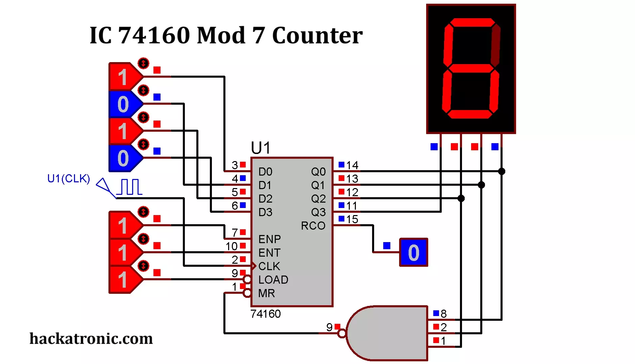

Slide 32
Shift Registers

Slide 33
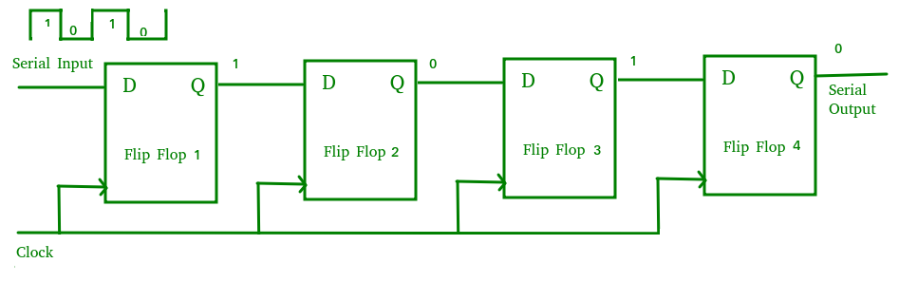
A shift register is a group of flip-flops connected in series to store and shift multiple bits of data either left or right with clock pulses.
The registers which will shift the bits to the left are called “Shift left registers”.
The registers which will shift the bits to the right are called “Shift right registers”.
Serial-In Serial-Out Shift Register (SISO)
A Serial-In Serial-Out (SISO) shift register accepts data one bit at a time through a single input line and outputs data serially, using a series of flip-flops all triggered by the same clock. The main use of a SISO is to act as a delay element.
Data enters and leaves one bit at a time in a serial sequence.
Typically made of multiple D flip-flops connected in series and synchronized by a common clock.

Slide 34
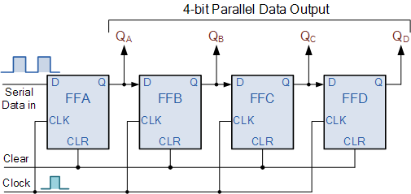
Serial-In Parallel-Out Shift Register (SIPO)
A Serial-In Parallel-Out (SIPO) shift register accepts data serially through a single input line and produces all bits simultaneously as a parallel output, using multiple synchronized flip-flops. The main use of the SIPO register is to convert serial data into parallel data.
Data is input one bit at a time and outputs all stored bits in parallel.
Consists of connected D flip-flops with a common clock and a clear (CLR) signal to reset all flip-flops.

Slide 35
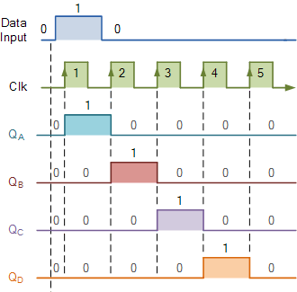
Clock Pulse No | QA | QB | QC | QD
0 | 0 | 0 | 0 | 0
1 | 1 | 0 | 0 | 0
2 | 0 | 1 | 0 | 0
3 | 0 | 0 | 1 | 0
4 | 0 | 0 | 0 | 1
5 | 0 | 0 | 0 | 0

Slide 36
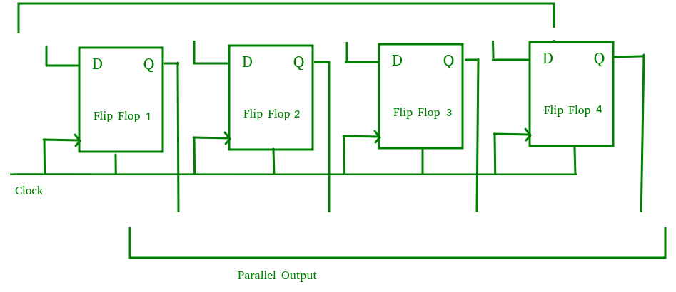
Parallel-In Parallel-Out Shift Register (PIPO)
A Parallel-In Parallel-Out (PIPO) shift register accepts and outputs data simultaneously across all flip-flops without any serial shifting, using synchronized control signals. It is used as a temporary storage device and also acts as a delay element.
Data is loaded and retrieved in parallel from each flip-flop at the same time.
Includes D flip-flops with no interconnections, controlled by common clock and clear (CLR) signals.

Slide 37
Parallel-In Serial-Out Shift Register (PISO)
A Parallel-In Serial-Out (PISO) shift register accepts parallel data simultaneously into each flip-flop and shifts it out serially through a single output line using synchronized flip-flops and multiplexers. It is used to convert parallel data to serial data.
Data is loaded in parallel and then shifted out one bit at a time serially.
Consists of D flip-flops with inputs controlled by multiplexers selecting between parallel data and previous flip flop output, all clocked together.
A PISO shift register is a digital circuit that can accept parallel data and output serial data. It is made up of a succession of flip-flops, with each flip-flop capable of storing one bit of data. Unlike PIPO shift registers, which offer parallel input and output, a PISO shift register accepts data in parallel and outputs it sequentially, or serially.
To understand the operation of a PISO shift register, let's consider a basic example with four flip-flops labeled D0, D1, D2, and D3. Each flip-flop can store one bit of data. The parallel data is loaded into the flip-flops simultaneously through the parallel input lines. Once the data is loaded, it can be shifted out in a sequential manner through the serial output.

Slide 38
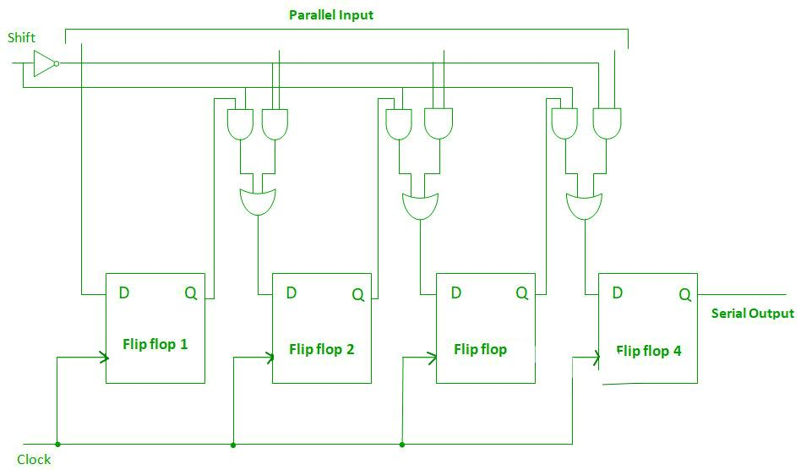

Slide 39
To shift the data out, a clock signal is applied to the shift register. Each clock pulse triggers the movement of data from one flip-flop to the next in a cascading fashion. The most significant bit (MSB) is usually the first to be shifted out, followed by the remaining bits. The serial output provides the bits one at a time, in the order they were loaded.
Example:
Let us consider, We have a PISO shift register with four flip-flops (D0, D1, D2, and D3) and a 2-to-1 multiplexer. Initially, all flip-flops are cleared and contain the value '0'. We want to load the binary value '1010' into the shift register using parallel input and then shift the data out serially.
Solution:
Step 1: Parallel Input To load the value '1010' into the shift register, we apply the parallel input as follows:
Data: 1 0 1 0
Step 2: Multiplexer Selection To facilitate the serial output, we use a 2-to-1 multiplexer. The inputs to the multiplexer are the outputs of the flip-flops (Q0, Q1, Q2, and Q3), and the select line of the multiplexer is controlled by the clock signal.
Initially, with the clock selecting the line at logic '0', the multiplexer selects the first input (Q0) as the output.
Step 3: Clock Cycle (Shift Out) Now, we activate the clock signal to shift the data out serially. Each clock pulse triggers the movement of data from one flip-flop to the next, and the output of the multiplexer represents the serial data.
Clock Cycle 1:
Data Out: 1 (Q0)

Slide 40
Clock Cycle 2:
Data Out: 0 (Q1)
Clock Cycle 3:
Data Out: 1 (Q2)
Clock Cycle 4:
Data Out: 0 (Q3)
After four clock cycles, the binary value '1010' has been shifted out serially, with the MSB (Most Significant Bit) appearing first and the LSB (Least Significant Bit) appearing last.
In this numerical example, the operation of a 4-bit PISO shift register with the use of a multiplexer is demonstrated. The binary value '1010' is loaded in parallel, and by applying clock cycles, we obtained the serial output '1010' through the multiplexer.
The combination of a PISO shift register and a multiplexer enables the efficient conversion of parallel data into a sequential, serial output, facilitating various applications such as data transmission, sensor systems, and more.

Slide 41
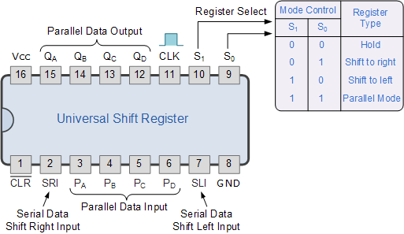
The Universal/ Bi-Directional Shift Register
Today, there are many high speed bi-directional “universal” type Shift Registers available such as the TTL 74LS194, 74LS195 or the CMOS 4035 which are available as 4-bit multi-function devices that can be used in either serial-to-serial, left shifting, right shifting, serial-to-parallel, parallel-to-serial, or as a parallel-to-parallel multifunction data register, hence their name “Universal”.
These universal shift registers can perform any combination of parallel and serial input to output operations but require additional inputs to specify desired function and to pre-load and reset the device.
4-bit Universal Shift Register 74LS194

Slide 42
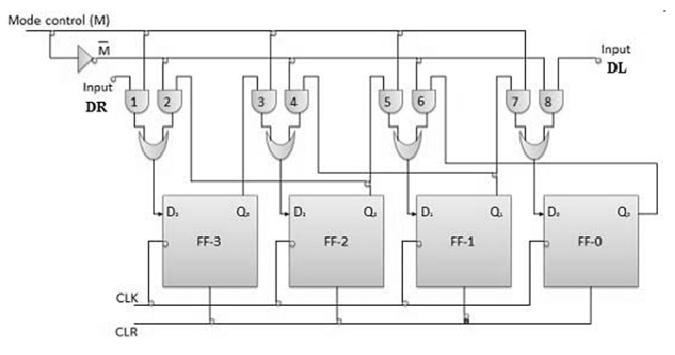
Bi-Directional Shift Register

Slide 43
Ring & Johnson Counter using Shift Registers

Slide 44
Ring Counter
The Johnson Ring Counter consists of a number of counters connected together with the output fed back to the input.
If we apply a serial data signal to the input of a Serial-in to Serial-out Shift Register, the same sequence of data will exit from the last flip flip in the register chain.
This serial movement of data through the resister occurs after a preset number of clock cycles thereby allowing the SISO register to act as a sort of time delay circuit to the original input data signal.
But what if we were to connect the output of this shift register back to its input so that the output from the last flip-flop, QD becomes the input of the first flip-flop, QA. We would then have a closed loop circuit that “recirculates” the same bit of DATA around a continuous loop for every state of its sequence, and this is the principal operation of a Ring Counter.
Then by looping the output back to the input, (feedback) we can convert a standard shift register circuit into a ring counter. Consider the circuit next.

Slide 45
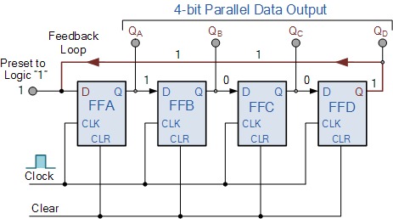
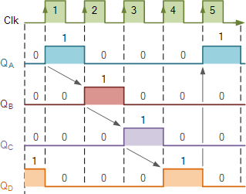
4-bit Ring Counter

Slide 46
4-bit Ring Counter
The synchronous Ring Counter example, is preset so that exactly one data bit in the register is set to logic “1” with all the other bits reset to “0”.
To achieve this, a “CLEAR” signal is firstly applied to all the flip-flops together in order to “RESET” their outputs to a logic “0” level and then a “PRESET” pulse is applied to the input of the first flip-flop ( FFA ) before the clock pulses are applied. This then places a single logic “1” value into the circuit of the ring counter.
So on each successive clock pulse, the counter circulates the same data bit between the four flip-flops over and over again around the “ring” every fourth clock cycle. But in order to cycle the data correctly around the counter we must first “load” the counter with a suitable data pattern as all logic “0’s” or all logic “1’s” outputted at each clock cycle would make the ring counter invalid.
Since the ring counter example shown above has four distinct states, it is also known as a “modulo-4” or “mod-4” counter with each flip-flop output having a frequency value equal to one-fourth or a quarter (1/4) that of the main clock frequency.

Slide 47
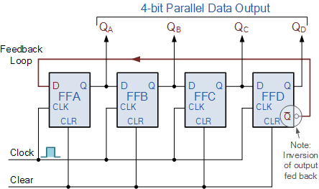
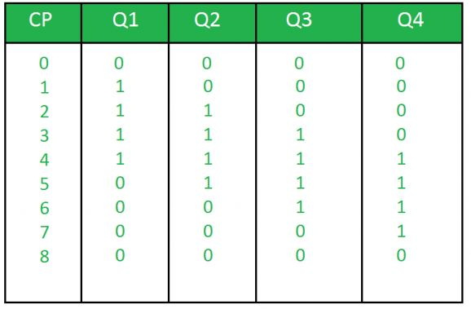
Johnson Ring Counter
A Johnson counter is a type of a synchronous counter with a special counting pattern in this case being Johnson counter. It operates by the complemented output of the last flip flop feed back into the input of the first flip flop. What results from this setup is a series of states which forms a sequence that is not characteristic of normal ring counters.

Slide 48
Difference Between Ring Counter and Johnson Counter
Parameters | Ring Counter | Johnson Counter
Configuration | A ring counter employs the carry-in of the last flip-flop into the input of the first flip-flop without any manipulation. | In Johnson counter, the complement of output of the last flip-flop is applied to the input of the first flip-flop.
Number of Flip- Flops | 'n' flip-flops are required to count 'n' states. | 'n' flip-flops are required to count '2n' states.
Counting Sequence | It counts in a simple binary sequence often having one '1' and the rest '0's in each state. | It counts in a twisted sequence, where the output is a mixture of binary 1s and 0s.
Number of States | It can Generate 'n' unique states | It can Generate '2n' unique states
Unused states | None, because all the states are utilized | '2n-2n' states are unused
Self-Decoding Capability | Its not self-decoding since additional circuitry is needed | Its self-decoding makes it simpler for certain applications
Circuit Complexity | Since it does not require inversion feedback, thus the circuit is simple | Due to inversion, the circuit is slightly more complex

Slide 49
Some Key Terminologies For PISO Shift Registers
Shift Register: A digital circuit that allows sequential shifting of data bits. It consists of a chain of flip-flops where data moves from one flip-flop to the next during each clock cycle.
Parallel-In Serial-Out (PISO): A type of shift register that accepts parallel input data and produces a sequential output. It loads data in parallel and outputs it in a serial manner.
Flip-Flops: Storage elements within a shift register that can store one bit of data. In a PISO shift register, each flip-flop represents a stage through which data passes during the shifting process.
Parallel Input: The process of loading data into the shift register simultaneously through multiple input lines. Parallel input allows for fast and efficient data transfer into the shift register.
Serial Output: The sequential output of data from the shift register, bit by bit, in a serial manner. The output represents the data that has been shifted through the register.
Clock Signal: A timing signal that controls the shifting operation in the shift register. Each clock pulse triggers the movement of data from one flip-flop to the next, enabling the sequential shifting process.
Most Significant Bit (MSB): The leftmost bit of the parallel input or serial output in a binary representation. It represents the highest value or the most significant position within the data.
Least Significant Bit (LSB): The rightmost bit of the parallel input or serial output in a binary representation. It represents the lowest value or the least significant position within the data.
Data Transmission: The process of sending data from one device to another. PISO shift registers are commonly used in data transmission applications, converting parallel data into a serial format for efficient transmission over serial communication channels.
Serial-to-Parallel Conversion: The process of converting serial data into parallel format. PISO shift registers can be used to load serial data and then output it in parallel, enabling the interfacing between serial and parallel systems.

